Slide 1
MCO
Group 10
Budol Finds

Slide 2
Introduction
Our proposed web application is for shoppers to share their bought items to recommend to fellow shoppers. The idea was taken from the private Facebook group, Home Buddies, with over 3 million members. The Facebook group’s posts cover different topics and purposes, however, the group decided to take on the idea of sharing “budol finds”, which are items that were bought and enjoyed by home shoppers.
The web application’s main aim is to provide a platform of consolidated “budol finds” for shoppers to make sharing and finding items easier, rather than a general Facebook group page. Through the web application, shoppers are given a better shopping experience as items they wish to buy are items suggested by fellow shoppers. It also makes it easier to shop as items are organized by categories and provided with a link or destination on where it can be bought.
The web application would require a user to create an account before they are able to share their finds. The user can then create a post containing what they bought, where to find it, and a media attachment of the item. The website would have a user page, home page/timeline, and different pages organized by item category (e.g.: ‘Women’s Clothing’, ‘Men’s Clothing’, ‘Home’, ‘Pet Supplies’, etc.).

Slide 3
Page Structure
How the website routes are structured?

Slide 4
Page Structure
GET: /
POST: /login/in
GET: /logout
POST: /logout/out
GET: /home
POST: /post/<posthash>/edit
PATCH: /post/<posthash>/save
GET: /signup
POST: /signup/save
GET: /profile
GET: /profile/settings
PATCH: profile/settings/save
DELETE: /post/<posthash>/delete
DELETE: profile/settings/delete
GET: /user/<username>
POST: /post/new
POST: /post/like
POST: /post/report
POST: /post/comment
GET: /post/<posthash>
NONE: /validate
POST: /validate/password
POST: /validate/username
NONE: /debug
Various debugging segments which are only accessible if request is executed by localhost.
GET: /login
GET: /profile/<search>
GET: /user/<username>/search
GET: /search/<search>.<category>
PUT: /profile/<search>/more

Slide 5
Data Model
How the data in the database is primarily structured?

Slide 6
User object
user
userId
username
passhash
email
fname
mname
lname
gender
bio
profilepic
System Generated, Derived from the plaintext password
System Generated

Slide 7
User object
user
userId
username
passhash
email
fname
mname
lname
gender
bio
profilepic
System Generated, Derived from the plaintext password
System Generated

Slide 8
Post object
post
userId
description
category
label
link
imgurl
postHash
datetime
editdatetime

Slide 9
Comment object
comment
userId
text
postHash
datetime
username

Slide 10
Report object
report
userId
postHash
datetime
postOwnerId

Slide 11
Website Design
How will the pages of the web application look like?

Slide 12
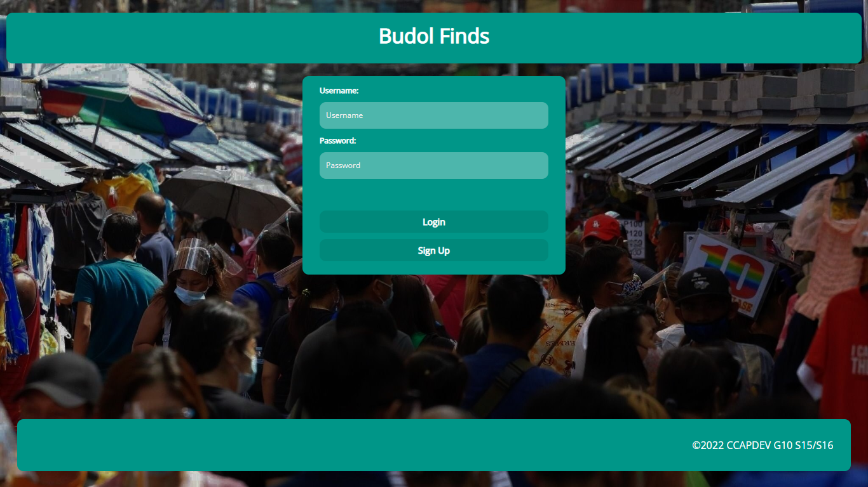
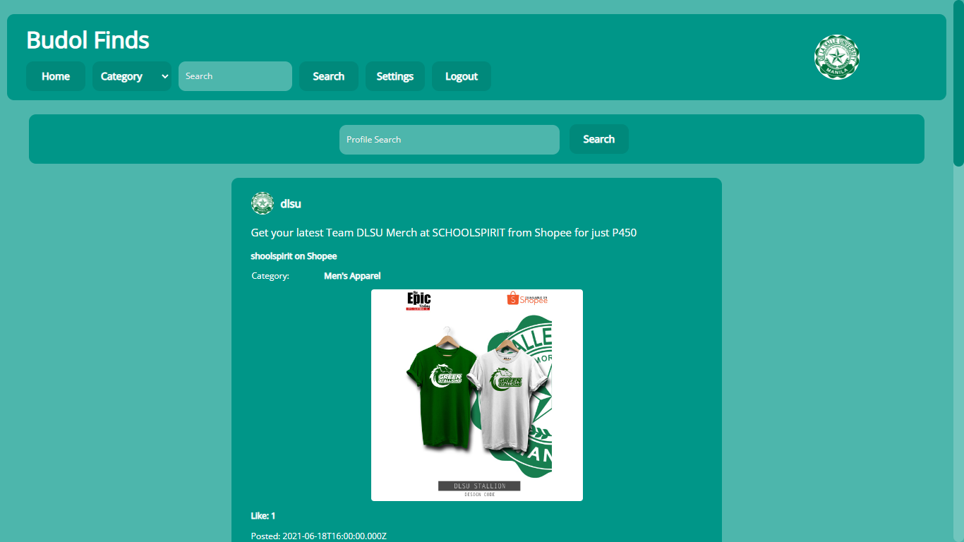
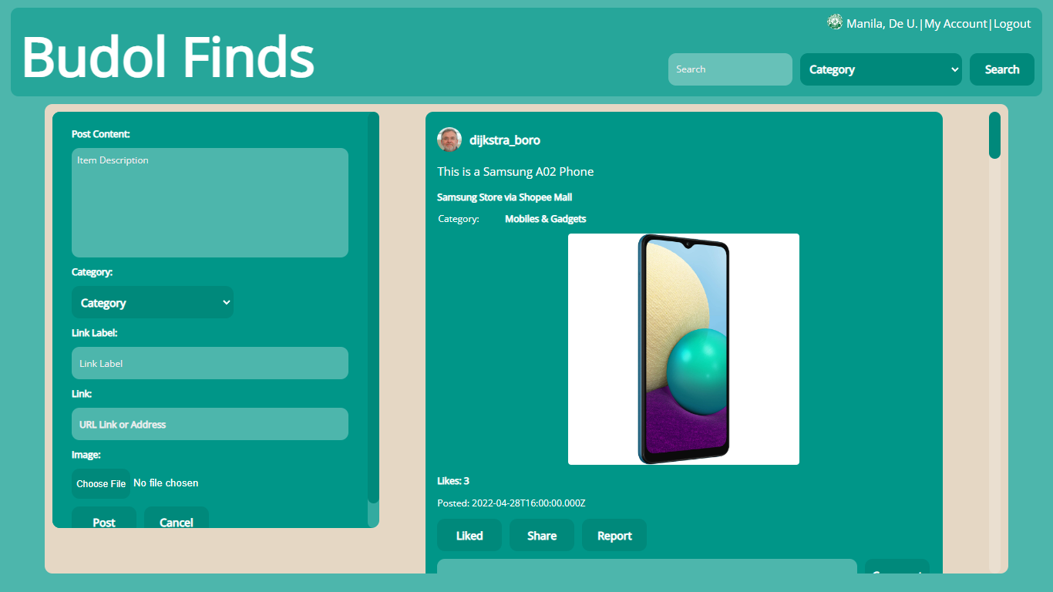
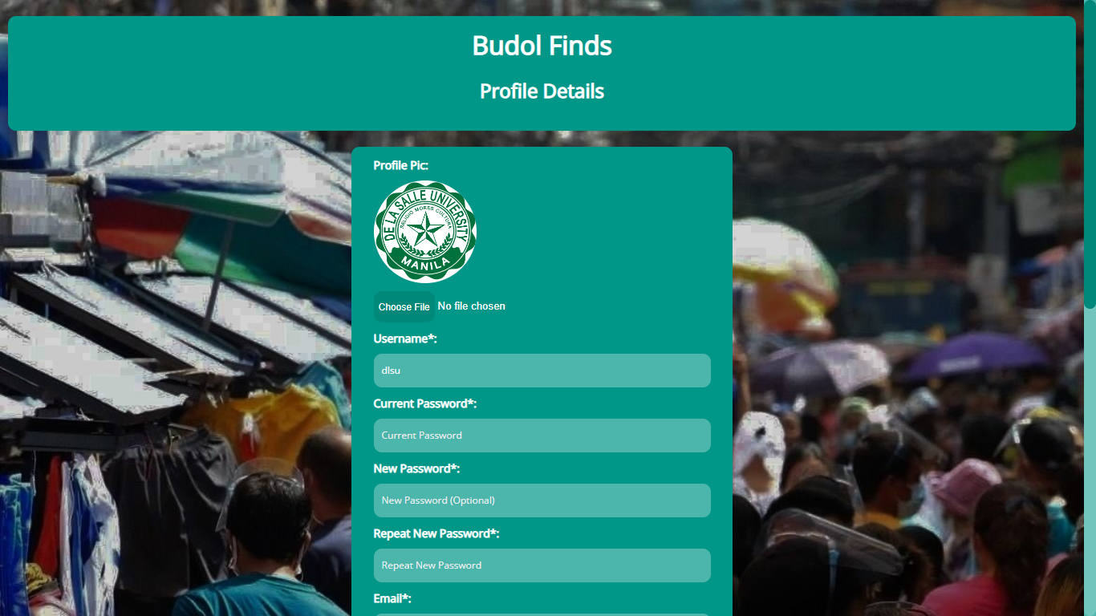
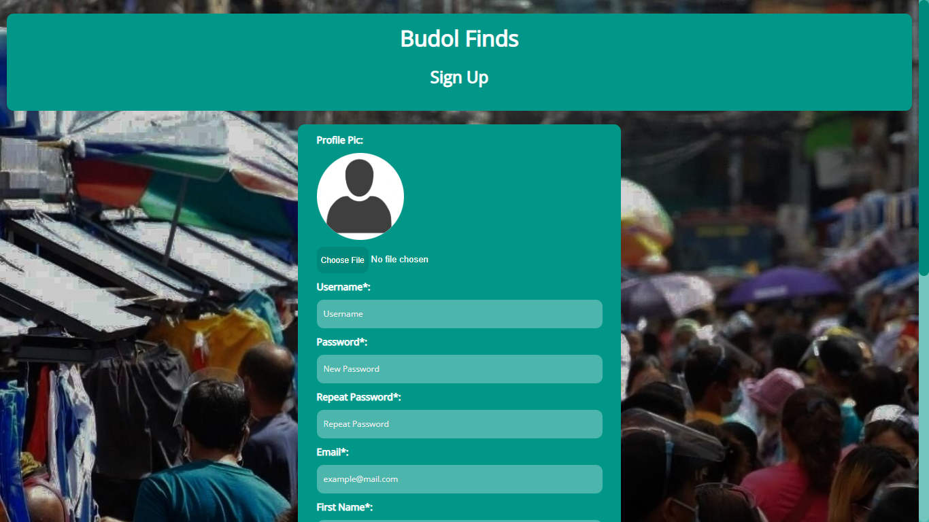
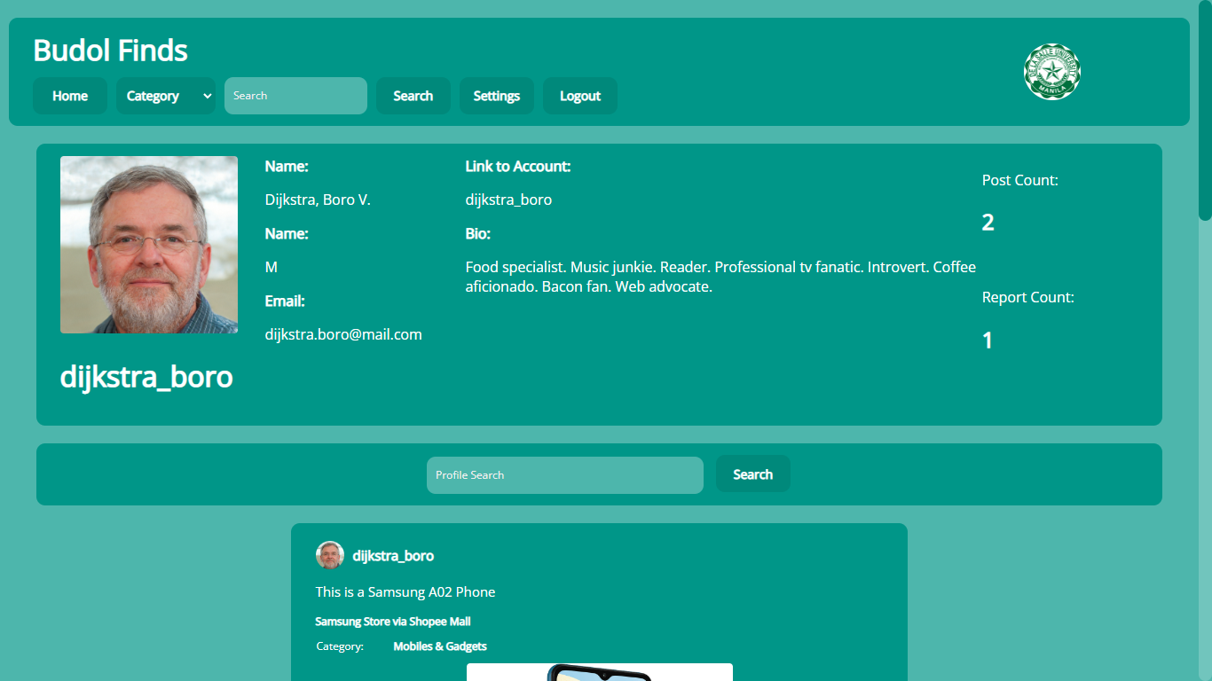
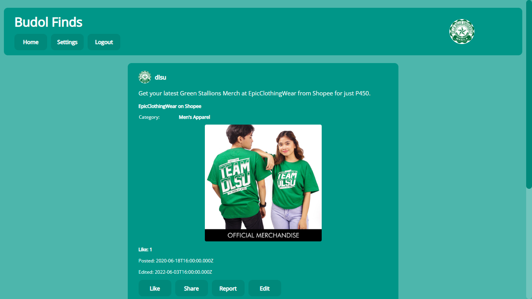
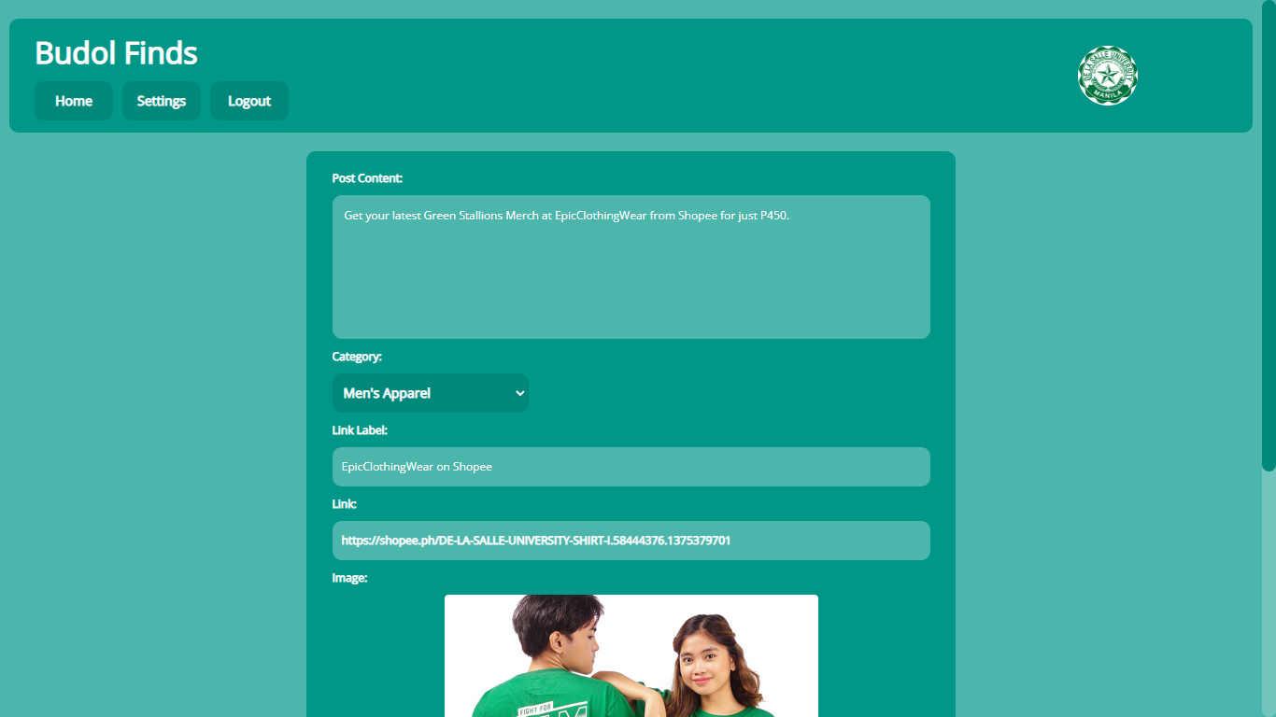
Website Designs

Slide 13
Web Application Functionalities
Capabilities and Limitations of the Web Application

Slide 14
Technologies Used
What technologies are used to build the web application?

Slide 16
Target Heroku Domain
https://budolfinds.herokuapp.com

